Slide 1
Optimizing the University Grading System for Comprehensive CGPA Calculation
PRESENTED BY
R.SanthoshKumar (192211053)
S.Vicky Melwin (192211058)

Slide 2


Introducing University Grading System
Optimization
A comprehensive CGPA system ensures fairness in student evaluations by offering consistent, transparent, and standardized grading practices.
Traditional grading methods often struggle with subjectivity, grade inflation, and inconsistencies across different departments or institutions.
CGPA calculation integrates diverse evaluation components to provide a more accurate representation of a student's academic performance.
It minimizes biases, making evaluations more objective and equitable for students across various courses and disciplines.
A robust CGPA system supports both educators and students by providing a reliable measure of academic achievements.

Slide 3

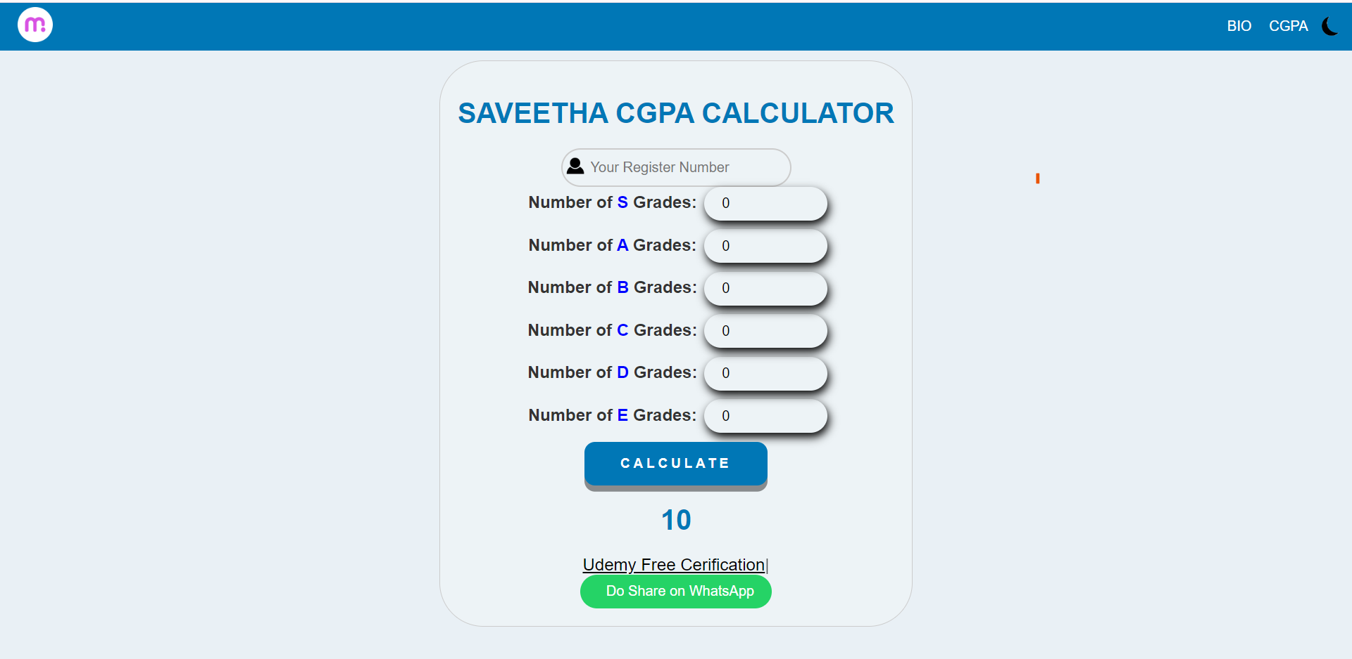

Slide 4

Limitations of Current Grading Practices
Analyze the shortcomings of existing grading systems, such as subjective grading, inconsistent weighting of assessments, and the inability to accurately capture overall academic performance.

Slide 5


Discover a robust methodology for calculating Cumulative Grade Point Average (CGPA) that considers various assessment components, course weights, and grade point scales to provide a holistic evaluation.

Slide 6

Ensuring Fairness and Transparency
Explore the implementation of standardized grading criteria, automated grade calculations, and transparent reporting to minimize bias and promote fairness in the evaluation process.

Slide 7

Integrating Technology for Efﬁcient
CGPA Tracking
Discuss the integration of technology- driven solutions, such as learning management systems and student information systems, to streamline CGPA tracking, data analysis, and reporting.

Slide 8


Conclusion: Towards a Comprehensive Grading System
Summarize the key beneﬁts of an optimized university grading system, including improved student motivation, informed decision-making, and enhanced institutional reputation. Highlight the future implications and potential for further research.

Slide 9
Thank you!

